Slide 1
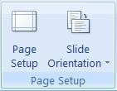
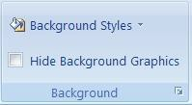
Diyala University / engineering collage Communication department
Computer science
.
Page Setup
Page setup provides you with the tools to slide size and orientation. The slide size option allow for some predefined sizes like letter, legal,
overhead, and tv aspect ratios like 4:3 standard resolution and 16:9 widescreen.
Themes
The themes section gives predefined colour, fonts and effects or you can choose your own.
Background
The background section lets you choose a background style or hide the background on the selected slide..
Animations Tab
The animations tab contains three sections, preview, animations and transitions to this slide.
Preview
The preview section will show you’re the current slides animation to allow you to check it is the way you want it.

Slide 2
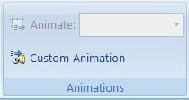
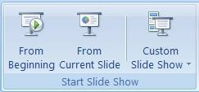
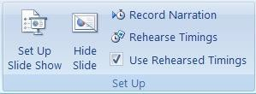
Diyala University / engineering collage Communication department
Computer science
.
Animations
Here you can create your own animations for use in the slide.
Transition to This Slide
The remainder of the Animations tab is taken up by the Transition to This Slide section. Here you can apply different transitions to be used between slides like fades, slides and many more. You can set options for speed, sounds, and timing.
Slide Show Tab
The Slide Show tab contains three sections, start slide show, set up and monitors.
Start Slide Show
The start slide show section is used to start your slide show either from the beginning or the current slide. You can also
use this section to create a custom slide show. Custom slide shows can be used to create one thirty-minute presentation and one sixty minute
presentation using the same set of slides but omitting some for the shorter show.
Set Up
The main features of this section are setup a slide show, record narration and rehearse timings.

Slide 3
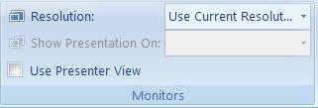
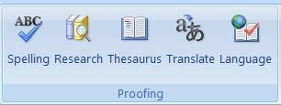
Diyala University / engineering collage Communication department
Computer science
.
Monitors
This section provides the tools to change the resolution of the slide show choose which monitor to display it on if
you have multiple monitors and use presenter view if you have multiple monitors.
Review Tab
The review tab offers three sections which include proofing, comments, and protect.
Proofing
The proofing section provides the standard spelling check, a thesaurus, research tools that include MSN search and
Microsoft Encarta encyclopedia. You will also find translation tools to help with single words or the whole document. The translation of the entire document is done by an
online service called Wordlingo.
Comments
The comments section allows you to add comments to a document for easier collaboration. You can cycle through the
comments to find out what notes you left for yourself or others and you can delete a
comment that was made when it is no longer relevant.

Slide 4
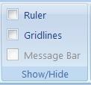
Diyala University / engineering collage Communication department
Computer science
.
Protect
The protect section gives you options to add a password and protect the document. You can restrict changes to formatting and editing or the whole
document. If you use Windows Live, you can also manage permissions for specific users
who also have Windows Live.
View Tab
The view tab offers six sections which include presentation views, show/hide, zoom, Color/Greyscale, window and macros.
Presentation Views
The presentation views section switches you between normal, slide sorter, notes page, slide show, slide master,
handout master and notes master. Normal shows you one slide in the centre with
thumbnails of all slides to the left of the screen. Slide sorter fills the centre with thumbnails of all slides which you can drag around to sort them. The notes page view shows the slide on the top section and notes you add in a bottom section. Slide show will start the slide show from the beginning. The Slide master, handout master and notes master views allow you to change what the presentations themes will follow by working with a master setup. Each of these master views also provide another tab to the ribbon.
Show/Hide
The show/hide section will toggle certain tools on or off the screen including rulers, gridlines and message bar. The rulers will show along the top and left side of the screen. Gridlines will cover your entire document inside the
margins. They will be visible on screen but don’t print. The message bar can only be

Slide 5
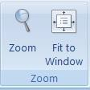
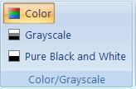
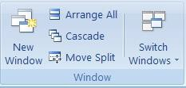
Diyala University / engineering collage Communication department
Computer science
.
displayed when there is a message to be displayed. One common reason for the message bar to display is when macros have been enabled or disabled.
Zoom
The zoom section provides tools to zoom into or out of the document. You can choose your own zoom factor or use one of the predefined zoom factors.
Color/Greyscale
This section allows you to switch between color, grayscale or pure black and white. This will allow you to see how slides will look when
printed on a black and white printer.
Window
The new window button will open your current document in a new window. The arrange all button will take your currently open
windows and stack them one on top of the other. This is also where you can easily switch between windows.
Macros
The macros section provides the tools required to work with and create basic macros. You can view existing macros or record your own. Choose record macro
from the drop down and then perform the functions you do often, like change the page
layout, and style of the document. Once you have done those tasks then stop recording. You will be able to use that macro over again to shorten the steps you need to take every time you need to perform that set of tasks.

